Slide 1
HOMEOSTASIS
Negative Feedback Loops

Slide 2
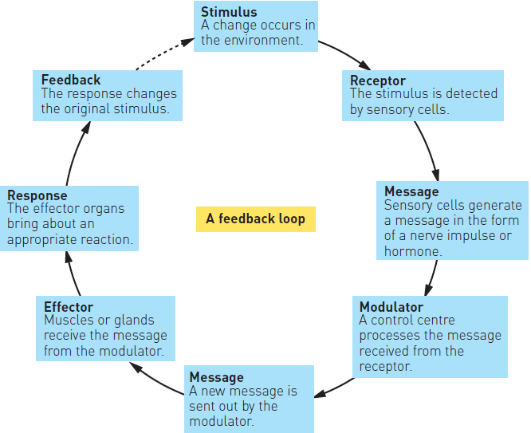
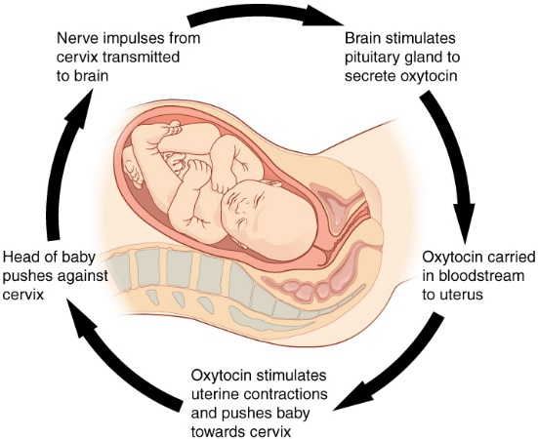
Negative vs Positive Loops
Positive feedback loop: self-amplifying cycle where a physiological change leads to a greater change in the same direction
Negative feedback: regulatory mechanism in which a stimulus causes an opposite output in order to maintain an ideal level of regulation

Slide 3
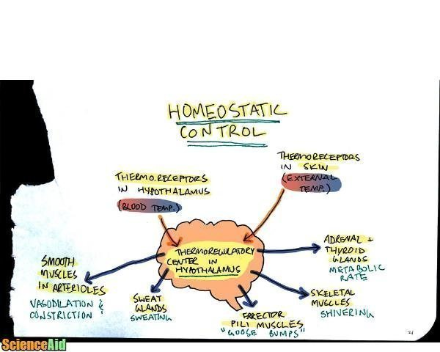
THERMOREGULATION

Slide 4
HEAT LOSS & HEAT GAIN
Heat loss: responded to by sympathetic nerves (autonomic)
Wind
Cold external temperatures
Not enough clothing
Heat gain: responded to by parasympathetic nerves
Warmer environment (humidity)
Excessive fat deposits (harder to lose heat)
Excessive clothing (traps heat)
Hyperthermia: body temperature above normal
Hypothermia: body temperature below normal
Mild – shivering, vasoconstriction, hypertension etc.
Severe – mental confusion, inability to speak, amnesia, death

Slide 5
LOOP (NERVOUS)
Stimulus: Increase Body Temperature
Receptor: Thermoreceptors (hypothalamus)
Message: Nerve Impulse
Modulator: Hypothalamus (interprets info + integrates response)
Message: Nerve Impulse
Effector: Sweat Glands, Blood Vessels
Response: More sweat secreted (evaporation of sweat = cooling), blood vessels dilate – vasodilation (more heat flow to surface of skin – heat lost via radiation, convection or conduction)
Feedback: Decrease Body Temperature

Slide 6
LOOP (HORMONES)
Stimulus: Increase Body Temperature
Receptor: Thermoreceptors (hypothalamus)
Message: Nerve Impulse
Modulator: Hypothalamus (interprets info + integrates response)
Message: Sympathetic Nerve Impulse
Effector: Adrenal Medulla (inhibit secretion of Adrenaline/Noradrenaline), Anterior Pituitary [inhibit release TSH to Thyroid Gland (inhibit thyroxine release)]
Response: Decrease metabolic rate
Feedback: Decrease Body Temperature

Slide 7
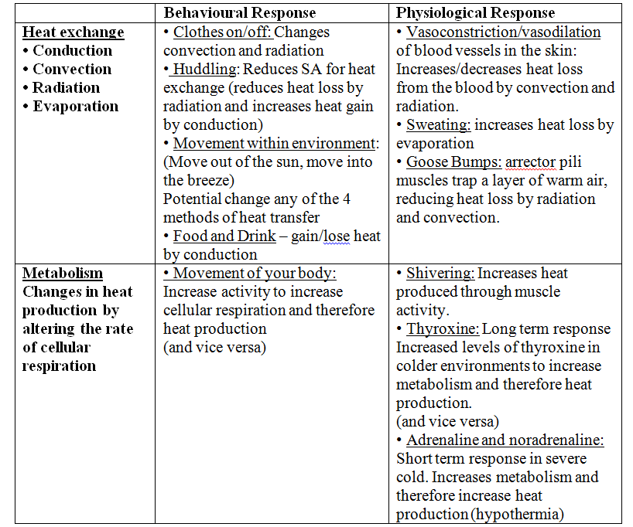

Slide 8
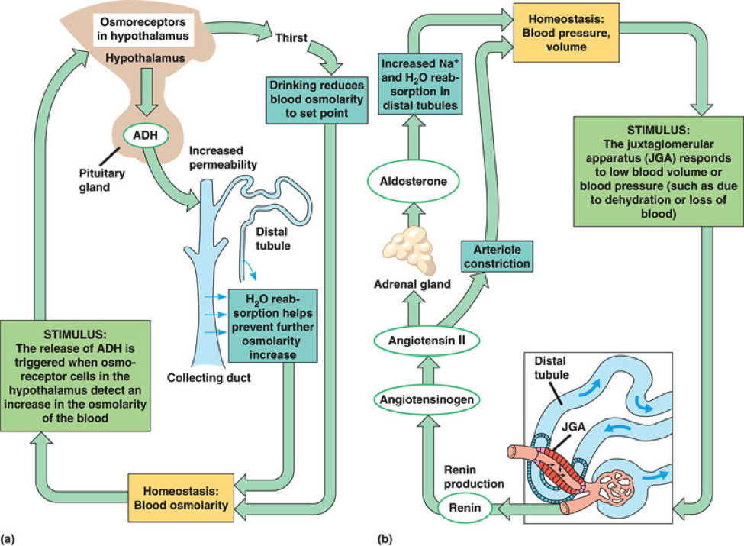
BODY FLUID CONCENTRATION

Slide 9
FLUID BALANCE
Fluid gained through:
Food + water intake
Fluid loss through:
Breathing, sweating, urine
Intracellular fluid: 60-66% of the water in the body (within body's cells)
Extracellular fluid: rest of body's water (30-33%)
Plasma (20%)
Interstitial Fluid (80%)

Slide 10
LOOP (HORMONES)
Stimulus: Increase Osmotic Pressure (decrease water concentration)
Receptor: Osmoreceptors (hypothalamus)
Modulator: Posterior Lobe (release ADH)
Effector: Distal Convoluted Tubule + Collecting Duct of nephron in kidney
Response: Increase permeability, Increase reabsorption of water into blood
Feedback: Decrease Osmotic Pressure (increase water concentration)

Slide 11
LOOP (HORMONES)
Stimulus: Decrease Osmotic Pressure (increase water concentration)
Receptor: Osmoreceptors (hypothalamus)
Modulator: Posterior Lobe (inhibit release ADH)
Effector: Distal Convoluted Tubule + Collecting Duct of nephron in kidney
Response: Decrease permeability, Decrease reabsorption of water into blood
Feedback: Increase Osmotic Pressure (decrease water concentration)

Slide 12
LOOP (CONSCIOUS)
Stimulus: Increase Osmotic Pressure (decrease water concentration)
Receptor: Osmoreceptors (thirst centre of hypothalamus)
Modulator: Modulator
Message: Nerve Impulse
Effector: Cerebrum – conscious thought (person feels thirsty)
Response: Thirst Reflex – activates drinking, water absorbed into blood from Alimentary Canal
Feedback: Decrease Osmotic Pressure (increase water concentration)

Slide 13
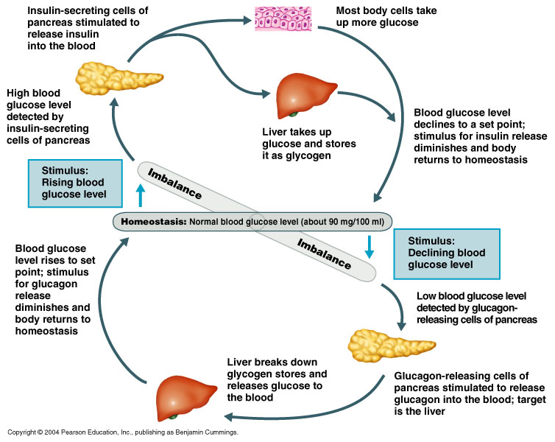
BLOOD GLUCOSE CONCENTRATION

Slide 14
LOOP
Stimulus: Increase Glucose Level
Receptor: B-cells (Islets of Langerhans in Pancreas)
Modulator: B-cells
Message: Insulin released
Effector: Liver, Body Cells, Fat Cells
Response: Glycogenesis – glucose → glycogen
Increase uptake of Glucose
Lipogenesis ( glucose → fats)
Feedback: Decrease Glucose Level

Slide 15
LOOP
Stimulus: Decrease Glucose Level
Receptor: A-cells (Islets of Langerhans in Pancreas)
Modulator: A-cells
Message: Glucagon released
Effector: Liver, Fat Cells
Response: Glycogenolysis (glycogen → glucose)
Gluconeogenesis (protein → glucose)
Fats → glucose
Feedback: Increase Glucose Level

Slide 16
LOOP
Stimulus: Decrease Glucose Level
Receptor: A-cells (Islets of Langerhans in Pancreas)
Modulator: Adrenal Cortex
Message: Cortisol released
Effector: Liver, Muscles
Response: Glycogenolysis (glycogen → glucose)
Glucogenolysis (protein → glucose)
Feedback: Increase Glucose Level

Slide 17
LOOP
Stimulus: Decrease Glucose Level
Receptor: A-cells (Islets of Langerhans in Pancreas)
Modulator: Medulla
Message: Adrenaline + Noradrenaline
Effector: Liver
Response: Glycogenolysis (glycogen → glucose)
Feedback: Increase Glucose Level

Slide 18
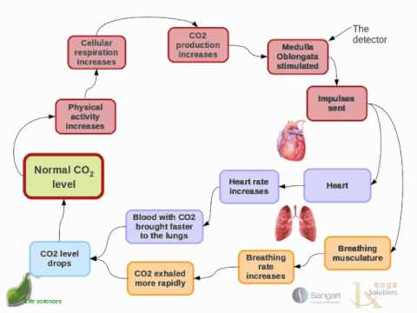
GAS CONCENTRATION

Slide 19
CONTROL OF BREATHING
Diaphragm: muscle causing air to move in/out of lungs
Stimulated by Phrenic Nerves
Intercostal muscle: skeletal muscles that require stimulation from nerve impulses to initiate contraction
Stimulated by Intercostal Nerves (origin in Spinal Cord)
If injured – complete paralysis of muscles ventilating lungs (death)
Oxygen + Carbon Dioxide concentrations affect breathing rate
CO2 concentration affects H+ ions concentrations
CO2 + H2O → H2CO3 → H+ + HCO3-
∴ Increase CO2 = Increase H+ ions = Decrease pH = Increase breathing rate

Slide 20
VOLUNTARY CONTROL OF BREATHING
Comes via connections from cerebral cortex to descending tracts in spinal cord
Bypasses respiratory centre in Medulla Oblongata
Hyperventilation: extreme rapid/deep breathing; may result in dizziness/fainting due to loss of CO2
Can be conscious (somatic), or times of physical stress (autonomic)
Causes constriction of the small blood vessels that supply the brain
Corrected by unstimulated chemoreceptors for CO2
Breathing into a paper bag – allows inhalation of exhaled CO2
Increased CO2 levels → increased H+ concentration → decreased O2

Slide 21
LOOP
Stimulus: Increase CO2 (Low pH, Low Blood Pressure)
Receptor: Chemoreceptors (carotid artery, aorta – peripheral, medulla – central)
Modulator: Respiratory + Cardiac centre in Medulla
Message: Sympathetic Nerves (heart), Phrenic + Intercostal Nerves
Effector: SA node of heart, Diaphragm + Intercostal muscles
Response: Increased heart rate + stroke volume, increased rate + depth of breathing
Feedback: Decrease CO2 (Increase pH, Increase Blood Pressure)

Slide 22
LOOP
Stimulus: Decrease CO2 (Increase pH, Increase Blood Pressure)
Receptor: Chemoreceptors (carotid artery, aorta – peripheral, medulla – central)
Modulator: Respiratory + Cardiac centre in Medulla
Message: Parasympathetic Nerves (heart), Phrenic + Intercostal Nerves
Effector: SA node of heart, Diaphragm + Intercostal muscles
Response: Decreased heart rate + stroke volume, Decreased rate + depth of breathing
Feedback: Increase CO2 (Low pH, Low Blood Pressure)

Slide 23
SYNTHETIC HORMONES
Biosynthetic insulin: inserting gene for human insulin production into bacteria/yeast cells, which are cultured. Because they have the gene for insulin production the cultured cells produce human insulin
Type 1
Onset: usually in childhood
Cause: destruction of Beta cells in Islets of Langerhans (insulin not produced)
Treatment: injection of insulin – cells respond normally to it
Type 2
Onset: Usually over 45 (more young people are affected nowadays)
Cause: lack of physical activity and overweight
Treatment: careful diet + regular physical activity (cells do not respond to insulin)

Slide 24
Hyperthyroidism: too much thyroxine
Thyroid produces too much hormone
Most common type is Graves’ disease.
Enlargement of thyroid due to immune system reaction
Symptoms: weight loss, increased appetite, increased heart rate, fatigue
Hypothyroidism: too little thyroxine
Deficiency of iodine in the diet
Surgery (removal of thyroid),
Autoimmune response (Hashimoto’s disease),
Problems with the pituitary or hypothalamus.
Symptoms: slow heart rate, weight gain, fatigue, intolerance to cold

Slide 25
Hyperthyroidism treatment
Radioactive iodine, surgery, anti-thyroid drug
Slows/stops production of thyroxine
Decreases metabolic rate + symptoms
Hypothyroidism treatment
Thyroid replacement hormone
Synthetic T4 works the same as natural T4
T4 in the bloodstream loses an iodine atom → T3 (conveys metabolic messages to cells)

